Slide 1



INTERN’s Project Presentation
Name : Amit Parmar
Batch: Batch 45
Location : Bengaluru
Degree: Bachelor Of Engineering (Computer Science)
LinkedIn Profie link: https://rb.gy/fu19ba

Slide 2
Contents
Business Objective
Business Constraints
Project Architecture - Data Flow Diagram
Data Collection
Exploratory Data Analysis
Data Visualization
Notes:
Change

Slide 3
Business Problem
Business Problem :
A manufacturing company experiences frequent and unexpected equipment failures, leading to significant production downtime, increased maintenance costs, and reduced overall efficiency. These failures disrupt operations, cause delays in product delivery, and negatively impact customer satisfaction and profitability.
Some of them are:
Frequent and Unpredictable Equipment Failures:
High Maintenance Costs
Inefficient Resource Utilization
Impact on Customer Satisfaction
Financial Implications

Slide 4
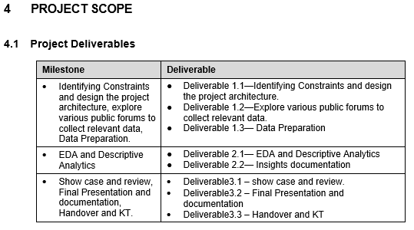
Project Overview and Scope
Project Introduction : This project addresses the issue of unplanned machine downtime at one of the leading vehicle fuel pump manufacturers. Unplanned downtime significantly reduces productivity and incurs substantial costs for the company.
Business Objectives: Minimize unplanned machine downtime
Project Scope:
Business Constraints: Minimize maintenance costs
Maximize equipment efficiency
Others
Success Citeria:
Business Success Criteria: Reduce unplanned downtime by at least 10%.
Economic Success : Achieve cost savings of at least $ 1 million.

Slide 5
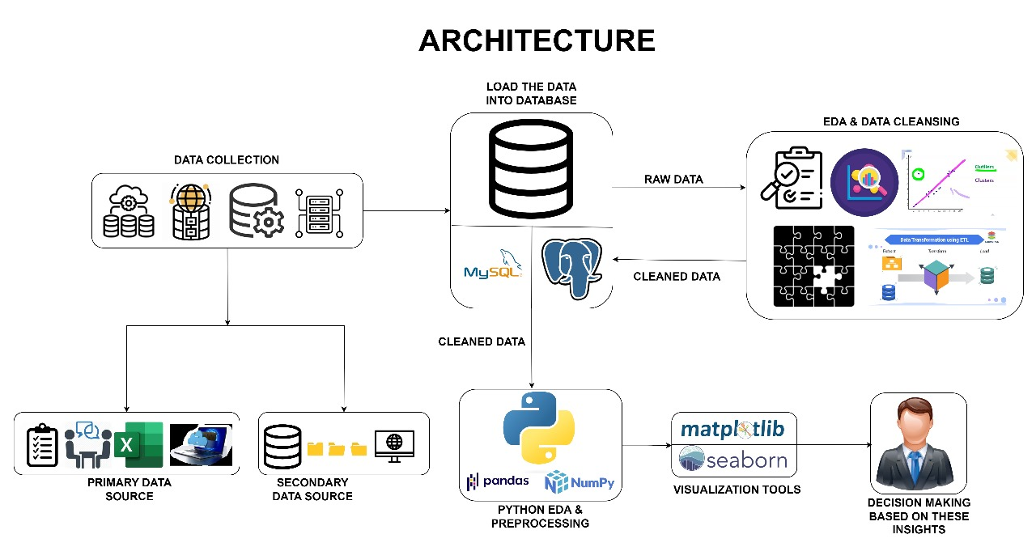
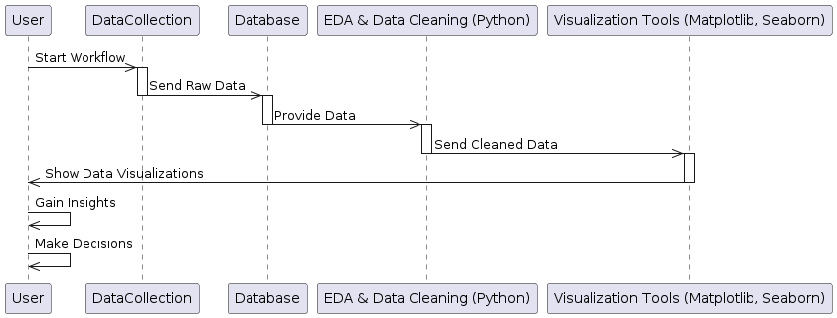
Project Architecture - Data Flow Diagram

Slide 6
Data Dictionary
Column Description:
<class 'pandas.core.frame.DataFrame'>
Index: 2381 entries, 0 to 2499
Data columns (total 16 columns):
# Column Non-Null Count Dtype # Column Non-Null Count Dtype
0 Date 2381 non-null object 11 Spindle_Speed(RPM) 2381 non-null float64
1 Machine_ID 2381 non-null object 12 Voltage(volts) 2381 non-null float64
2 Assembly_Line_No 2381 non-null object 13 Torque(Nm) 2381 non-null float64
3 Hydraulic_Pressure(bar) 2381 non-null float64 14 Cutting(kN) 2381 non-null float64
4 Coolant_Pressure(bar) 2381 non-null float64 15 Downtime 2381 non-null object
5 Air_System_Pressure(bar) 2381 non-null float64
6 Coolant_Temperature 2381 non-null float64
7 Hydraulic_Oil_Temperature(°C) 2381 non-null float64
8 Spindle_Bearing_Temperature(°C) 2381 non-null float64 dtypes: float64(12), object(4)
9 Spindle_Vibration(µm) 2381 non-null float64
10 Tool_Vibration(µm) 2381 non-null float64

Slide 7
Exploratory Data Analysis [EDA]
Coolant temperature prone to outliers, high variation, positively skewed, leptokuritic
Hydraulic oil temperatures stable, unaffected by outliers, low variation, negatively skewed, mesokurtic.
Spindle bearing temperature: stable, variable, negatively skewed
Spindle variation resilient to outliers, highly variable positively skewed, mesokurtic data
Measures of Central Tendency: Mean, Median and Mode
Measures of Dispersion: Variance, Standard Deviation and Range
Skewness, Kurtosis and Correlation
Business Insights
Regular maintenance is needed to keep hydraulic pressure within the optimal range to prevent machinery breakdowns
Monitoring spindle speed is crucial for identifying when machines are operating outside their optimal performance range.
Ensuring air system pressure stays within safe limits is essential to avoid operational hazards and ensure worker safety.
Tracking voltage usage can help identify opportunities for improving energy efficiency and reducing operational costs.
Comparing performance metrics across different assembly lines can identify best practices and areas for efficiency improvement.
Statistical Insights
Notes:
EDA is used for seeing what the data can tell us before the modeling task.
Change

Slide 8
Data Preprocessing
Steps for Data Preprocessing steps:
Data Cleansing / Data Preparation: Converting ‘Date’ to datetime and ‘Downtime’ to numeric
Outlier Analysis / Treatment: Identifying outliers using a relaxed Z-score threshold and remove them
Zero & Near Zero Variance Features: Remove features with near-zero variance
Discretization / Binning / Grouping: for example Discretize ‘Coolant Temperature’ into bins
Missing Values: filling missing values with the mean for numerical columns and mode for categorical col.
Dummy Variable Creation: Create dummy variables for categorical columns
Transformation: for example Log Transformation on specific column like Hydraulic Pressure
Feature Scaling / Feature Shrinking: Standard Scaling
Notes:
Keep observations

Slide 9
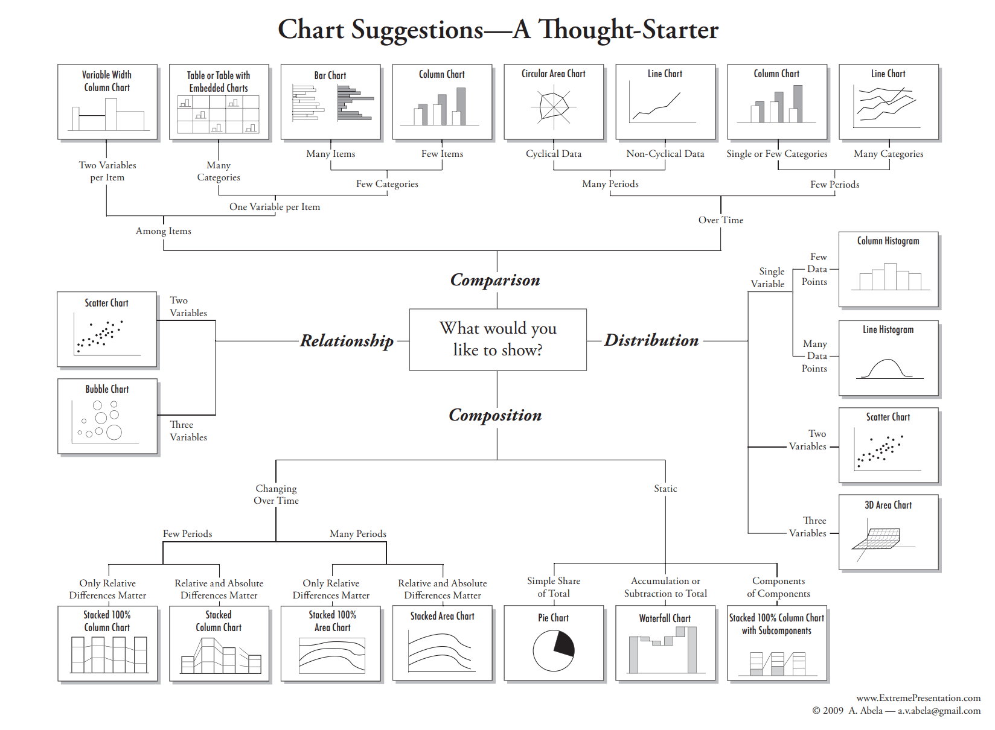
Data Visualization
Graph and Plot utilized for Visualization :
Bar Graph: Compares categories visually using rectangular bars
Index Plot: Displays changes relative to a reference point
Dot Plot: Visualizes distribution of data points
Strip Plot: Shows distribution of continuous data points
Violin Plot: Combines box plot and density plot
Histogram: Represents frequency distribution of continuous data
Density Plot: Displays probability density of continuous data
Box & Whisker Plot: Summarizes distribution of continuous data.
Scatter Plot: Examines relationship between two variables graphically
Pairs Plot: Shows relationships between multiple variables pairwise
Notes:
Add graphical

Slide 10


